Slide 1
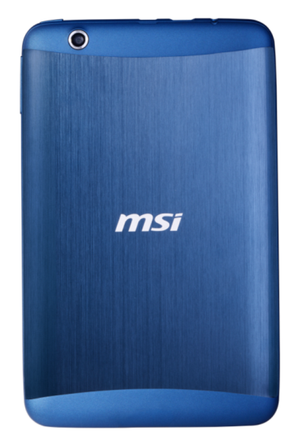
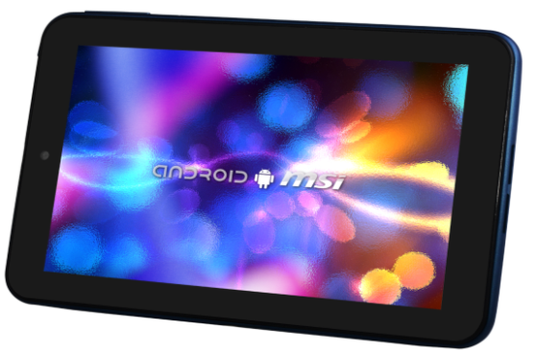
Make Your Spirits Soar
Android 4.0 Ice Cream Sandwich
Powerful 1.5Ghz Dual core processor
Smooth User Experience while Content Consumption
Thin 8.9mm, Light Metal Housing 299g
Dual Core GPU Optimized for IPS 7” LED Panel
Full High Definition 1080p Playback
Two-way camera
Micro-USB data transfer technology
Supports HD Mini-HDMI
Micro SD slot to expand memory capacity
Enjoy 71 Tablet

Slide 2
Enjoy71 Features
Powerful 1.5GHz dual core processor
The Enjoy 71 packs the latest, fastest 1.5GHz dual core processor, enhancing overall performance for a seamless experience no matter what program you're running.
Thin 8.9mm, Light Metal Housing 299g
Only 8.9mm thin, the Enjoy 71 weighs in at only 299g. Slim, light, and handy, the Enjoy 71 sports a casing with MSI's own peacock blue with brushed metal finish for a chic, classy look.
Dual Core GPU Optimized for IPS 7” LED Panel
Enjoy 71 comes with dual core GPU (Mali-400 MP2), high resolution Video DSP technology, 7-inch multipoint touch screen, IPS (in-plane-switching) for expanded viewing angle, and 1024x600 screen resolution. IPS offers optimized graphics stability and response time and when you watch videos with a friend, you don't have to worry about reduced viewing quality, because you have to view the screen from an angle.
Full High Definition 1080p Playback
The full HD 1080p (1920x1080) video resolution supports different video formats and when you're watching streaming video on the Internet, you don't have to worry about hardware limitations adversely affecting viewing quality. You can also connect the Enjoy 71 to larger monitors using the HDMI transfer interface for a truly cinematic experience.
Enjoy 71 Tablet

Slide 3
Enjoy71 Features
Two-way camera
The Enjoy 71 sports camera lenses on both the front and back. The front lens boasts 0.30 megapixels, so you can enjoy smooth conferencing with friends anytime, anywhere. The 2 megapixels rear lens is ideal for more technical photography that you can share with others.
Micro-USB data transfer technology
The Micro USB can be used for both transferring data and recharging, so you don't have to worry about data transfer problems, because you run out of power before you're done. The Enjoy 71 also supports OTG (On-The-Go) Cable which allows it to connect to various peripherals, such as phones, mouses, keyboards, external hard drives, or printers, to greatly enhance the expandability of this tablet.
Supports HD Mini-HDMI
The Mini-HDMI transfer interface allows you to connect to a notebook computer or LED TV for a bright, faithful, hiccup-free picture. The Enjoy 71 can be the core of your own home cinema.
Micro SD slot to expand memory capacity
The Enjoy 71's Micro-SD slot allows you to insert an expandable Micro SD memory card (up to 32GB), which, when coupled with the original 8GB, gives you a potential total of up to 40GB.
Enjoy 71 Tablet

Slide 4
Enjoy71 ID
Front Camera
Rear Camera
Volume
Up / Down
IPS 7”
1024x600
Speakers
Power button
Micro-USB
Earphone Jack
Mini-HDMI
Enjoy 71 Tablet

Slide 5
Enjoy71 Specification
Model | MSI Enjoy 71
Processor | Dual Core AML8726-MX 1.5GHz
OS | Android 4.0 Ice Cream Sandwich
Display | 1024 x 600 IPS 7” LED Panel
HDD | 8GB ROM
Memory / Storage | DDR3 1GB
Webcam | Front 0.3M FF / Rear 2.0M FF
Network | Wi-Fi (802.11 b/g/n)
HDMI | Mini-HDMI
USB 2.0 port | Micro-USB
Mic-in/Headphone-out | 3.5mm Headphone Jack
Card Reader | micro-SD(Max 32GB)
Wireless LAN | 802.11 b/g/n
AC Adapter | AC Input AC100～240V/DC 5V/2A
Battery Type | 3200mAh (support micro USB charging)
Dimension | 191 mm x 119 mm x 8.9 mm
Weight | 299g
Enjoy 71 Tablet

